Slide 1

Building Your First Pipeline
by Vishwanath MS

Slide 2



Building Your First Pipeline: Overview
A CI/CD pipeline is an automated sequence of steps in software development, from code changes to deployment. It streamlines the delivery process, ensuring efficient, rapid, and reliable software releases.
Development
Testing
Deployment
Developers write and commit code to a version control system.
Automated tests run to verify functionality, performance, and security.
Validated code is automatically released to production environments.
The entire pipeline is defined in a configuration file, typically
.gitlab-ci.yml
for GitLab CI/CD.

Slide 3

Anatomy of .gitlab-ci.yml
The entire CI/CD pipeline's structure and behavior are defined in a single .gitlab-ci.yml file, located at the project root.
YAML Format
Stages
A human-readable data serialization language that controls the entire pipeline.
Defines the sequential phases of the pipeline, like build, test, and deploy.
Jobs
Scripts
Specific tasks that belong to stages and define what commands to run.
The actual commands executed by each job, specified within the job's definition.

Slide 4
Defining Your Pipeline: Stages, Jobs, Scripts
stages:
- build
- test
- deploy
build-job:
stage: build
script:
- echo "Building the application"
test-job:
stage: test
script:
- echo "Running tests"
deploy-job:
stage: deploy
script:
- echo "Deploying application"
The structure of your pipeline is defined by three key sections:
Stages: Define the sequential phases of your pipeline (e.g., build, test, deploy).
Jobs: Named sections representing specific tasks executed within a chosen stage.
Script: Contains the actual commands that a job runs.
Here’s an example showing how these components work together:

Slide 5




Defining Stages – Best Practices
Understanding how stages operate is crucial for designing efficient and reliable CI/CD pipelines. Here are key principles:
Common Stages
Sequential Flow
Parallel Jobs
Leverage standard stage names like build, test, deploy, lint, and review for clarity and consistency across projects.
Stages execute in a defined order, from top to bottom as listed in your .gitlab-ci.yml, ensuring logical progression.
Jobs within the same stage run concurrently, significantly speeding up pipeline execution and maximizing resource utilization.

Slide 6




Job Configuration Options
Beyond the basic stages and scripts, GitLab CI/CD jobs offer powerful configuration options to control their behavior:
Script
Only / Except
Defines the exact commands executed by the job. This is the operational core of your job.
Controls when a job runs based on conditions like branches, tags, or specific file changes.
Tags
Artifacts
Assigns jobs to specific GitLab Runners with matching tags, ensuring they run in appropriate environments.
Specifies files or directories produced by a job that should be saved, shared, or downloaded for later use.
Here’s an example showing these options in action:
test-job:
stage: test
tags:
- python
script:
- npm install
- npm test
artifacts:
paths:
- coverage/

Slide 7
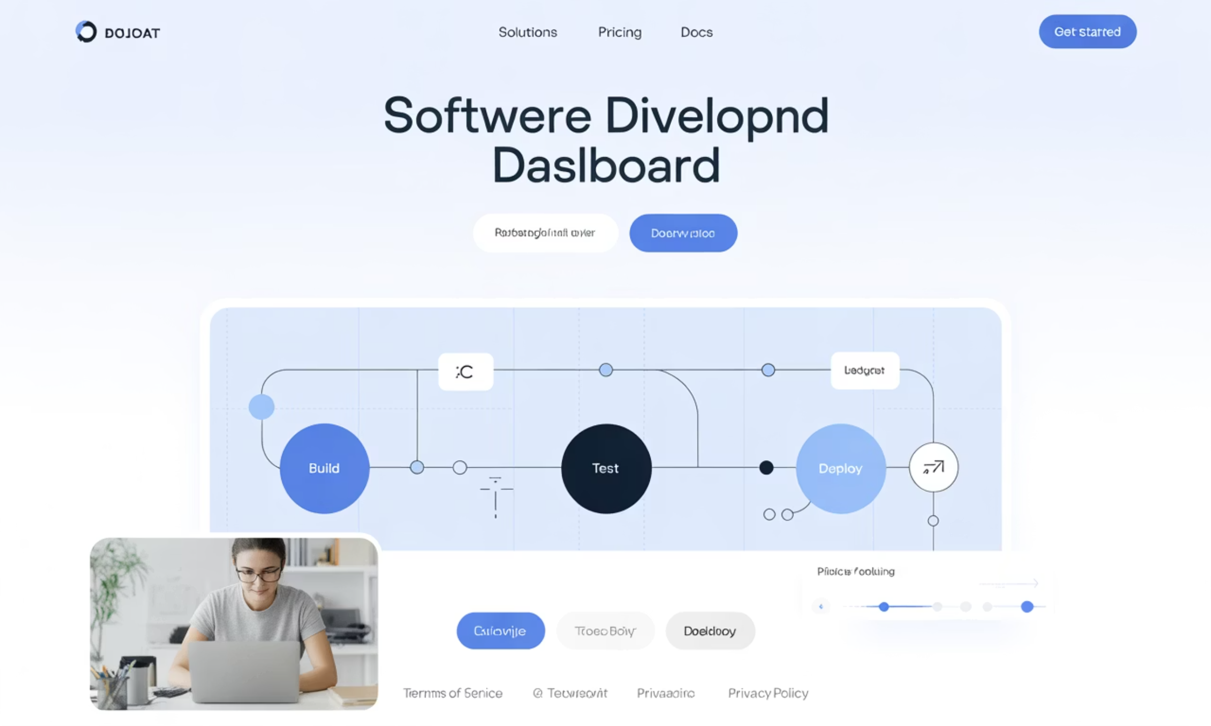
Hands-On: Building Your First Pipeline
Let's put theory into practice by creating a minimal CI/CD pipeline. Our goal is to set up a basic workflow that:
Builds the Application
Runs Tests
Reports Status
Ensuring your code compiles successfully.
Verifying the application's functionality.
Providing immediate feedback on pipeline execution.
Begin by creating a new file named .gitlab-ci.yml at the root of your project repository and add the following content:
stages:
- build
- test
build-job:
stage: build
script:
- echo "Compiling code..."
test-job:
stage: test
script:
- echo "Running unit tests..."
Once the file is created, add, commit, and push it to your repository. GitLab CI will automatically detect this file and initiate your first pipeline!

